Slide 1
CAPSTONE PROJECT -2 Bike Sharing Demand Prediction
By
Karan Rawat

Slide 2
Points to Discuss:
Agenda
Data summary
Data Reading
Exploratory Data Analysis
Metrics Selection
Modelling
Model Performance Comparison
Final Model
Summary
Conclusion
Challenges Faced

Slide 3

Agenda
Rental bikes are introduced in many urban cities for the enhancement of mobility comfort. It is important to make the rental bike available and accessible to the public at the right time as it lessens the waiting time. Eventually, providing the city with a stable supply of rental bikes becomes a major concern. The crucial part is the prediction of bike count required at each hour for the stable supply of rental bikes.

Slide 4
Data Summary
The dataset contains weather information (Temperature, Humidity, Windspeed, Visibility, Dewpoint, Solar radiation, Snowfall, Rainfall), the number of bikes rented per hour and date information.
Attribute Information:
Date : year-month-day
Rented Bike count - Count of bikes rented at each hour
Hour - Hour of the day
Temperature-Temperature in Celsius
Humidity - %
Windspeed - m/s
Visibility - 10m
Dew point temperature - Celsius
Solar radiation - MJ/m2
Rainfall - mm
Snowfall - cm
Seasons - Winter, Spring, Summer, Autumn
Holiday - Holiday/No holiday
Functional Day - NoFunc(Non Functional Hours), Fun(Functional hours)

Slide 5



Data Reading
The dataset contains total fourteen features.
The dataset has no missing values.
The dataset has both numerical and categorical features.
The response variable is “Rented Bike Count” as the job is predict rented bike counts per hour.

Slide 6
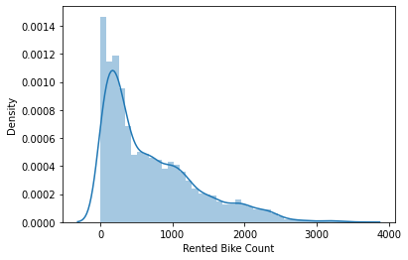
Exploratory Data Analysis
Response Variable
The distribution plot is used to visualize the variable.
As per the plot, the response variable has a positive skewness.

Slide 7
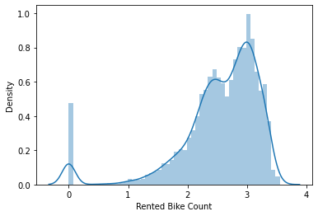
Transformations used to remove skewness from response variable
Log Transformation
Taking log transformation for dependent variable , don't help much as now distribution becomes negatively skewed.

Slide 8
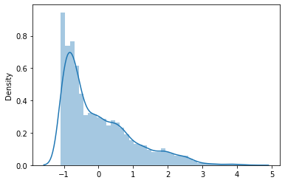
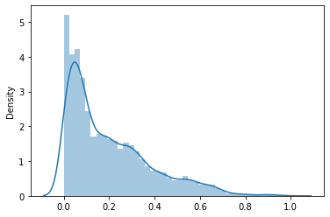
Standardization and Normalization
We can see that Standardization and Normalization don't really change the skewness in the distribution.

Slide 9
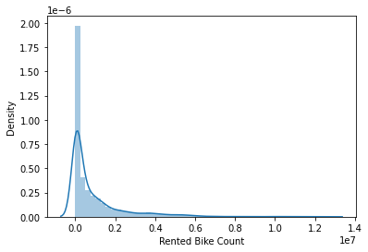
Quadratic Transformations
Square Transformation

Slide 10
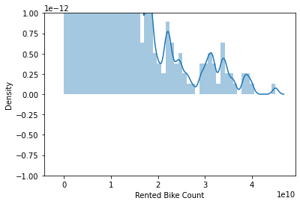
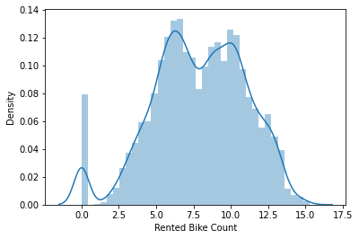
Cube Transformation
Cube Root Transformation

Slide 11
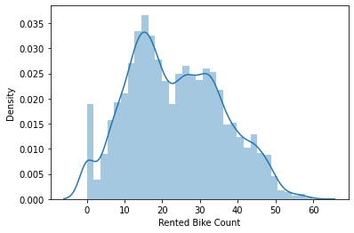
Square Root Transformation
The square root and cube root transformation removes the skewness but still the variable is not normally distributed. We will use square root transformation for regression as it transforms the variable with well distributed.
Note : For regression tasks it is important to standardize the dependent variable as well. That’s why transformations are used to check which one is removing skewness

Slide 12
Predictor Variables
In the dataset the "date" feature is given , so it is important to match it to the correct dtype.
The “date” feature is then splitted into three features “year”,”month” and “day”.
The "Hour" feature denotes time so it should has dtype as categorical not integer.
The numerical features are 'Temperature(°C)', 'Humidity(%)', 'Wind speed (m/s)', 'Visibility (10m)', 'Dew point temperature(°C)', 'Solar Radiation (MJ/m2)', 'Rainfall(mm)',and 'Snowfall (cm)'.
The categorical features are 'Hour', 'Seasons', 'Holiday', 'Functioning Day', 'year', 'month', and 'day'.

Slide 13
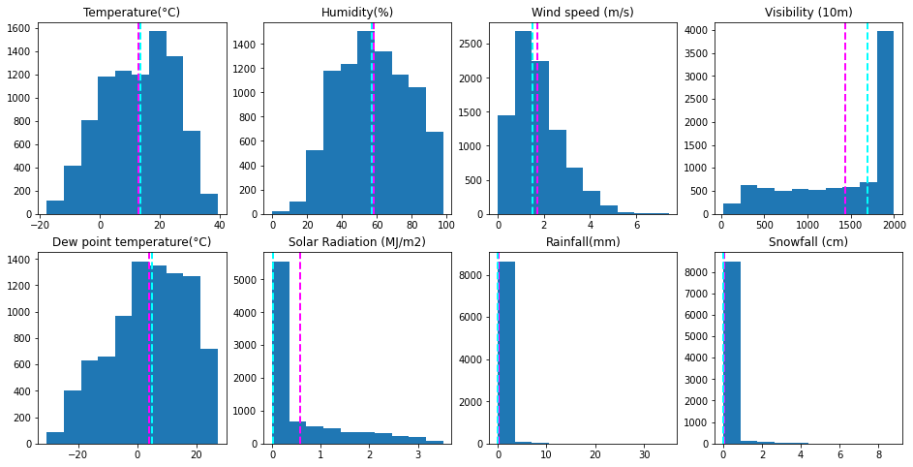
Numerical Features
Visualising using histogram plot.
The feature "Solar Radiation" has a high difference between their mean and median , so surely this feature contain outliers. Some features are skewed. Also we will check for outliers for all these features.

Slide 14
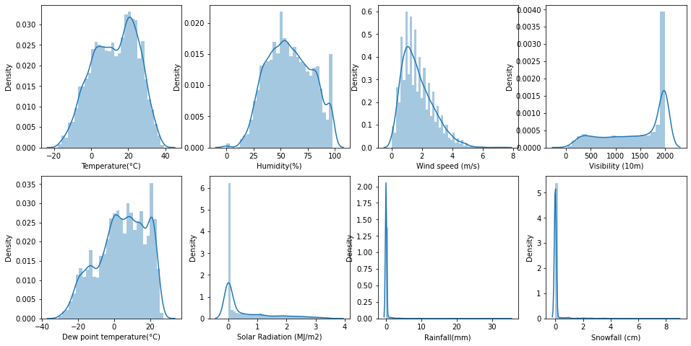
Visualising using distribution plots
The feature "Visibility" is negatively skewed and the features "Wind Speed", "Solar Radiation" ,"Rainfall" and "Snowfall" are positively skewed. So we have to take these things into consideration.

Slide 15
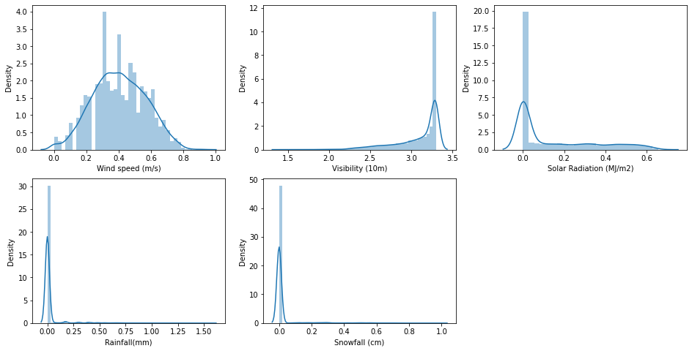
Let's try to find the solution to fix the skewed features.
Log Transformation

Slide 16
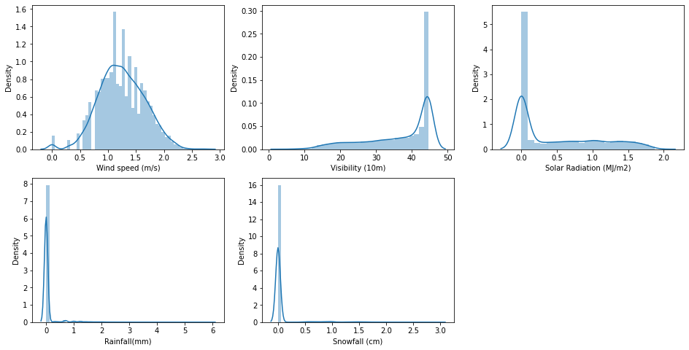
Square Root Transformation

Slide 17
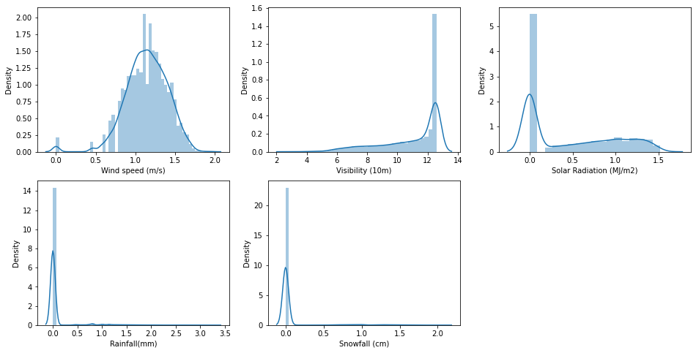
Cube Root Transformation
The transformations used not really remove the skewness in most of the features.However skewness from Wind Speed is removed while using square root transformation.

Slide 18
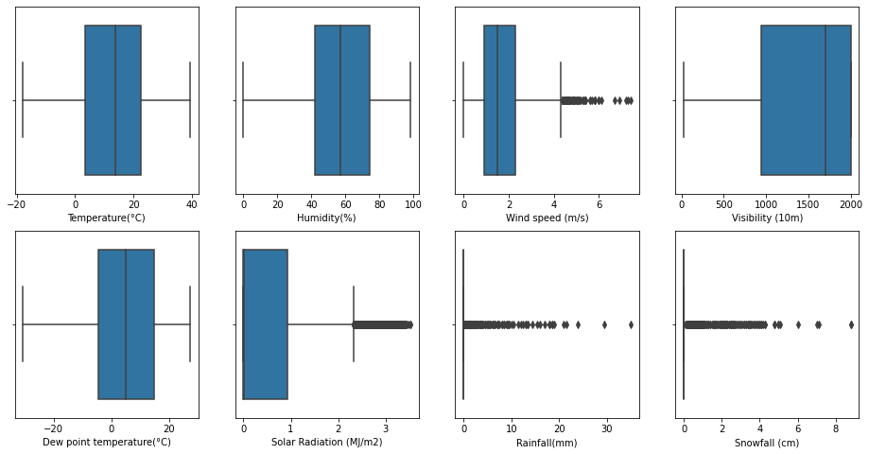
Check for Outliers
The features "Wind Speed","Solar Radiation","Rainfall","Snowfall" have outliers.

Slide 19
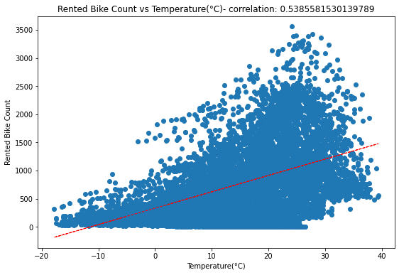
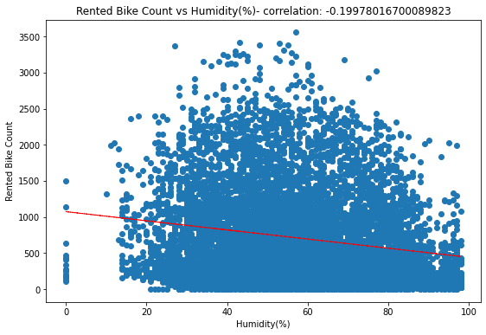
Check for relationship and correlation of each numerical predictor variable with response variable.

Slide 20
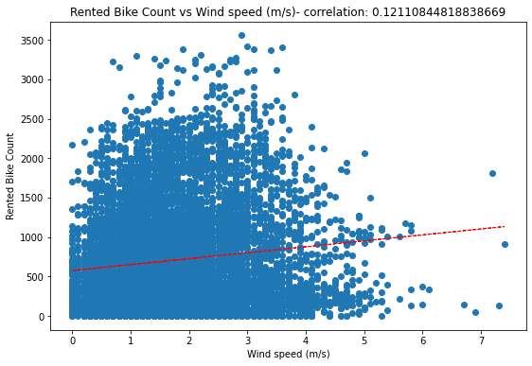
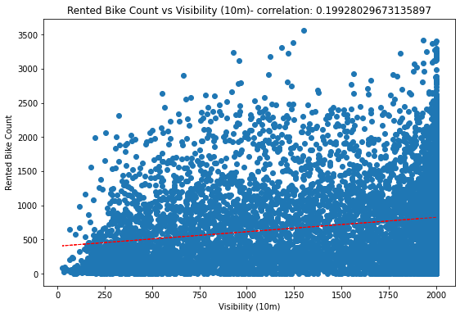
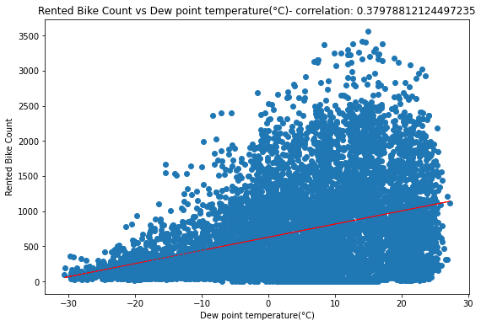
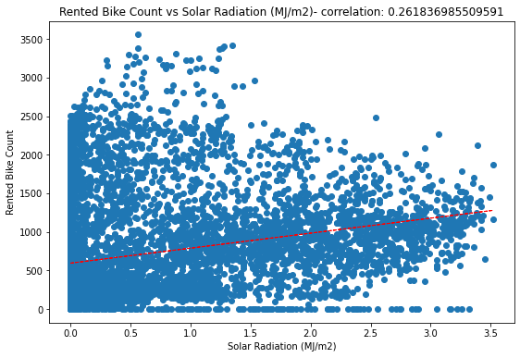

Slide 21
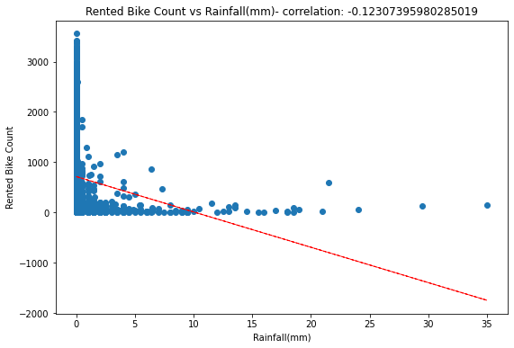
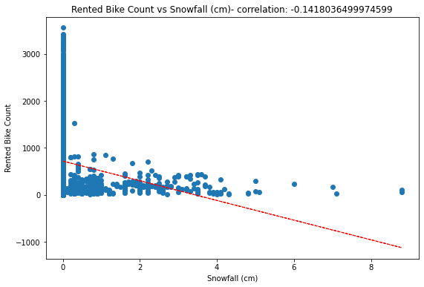
The features are less correlated with the response variable and don't follow linear relationship.

Slide 22
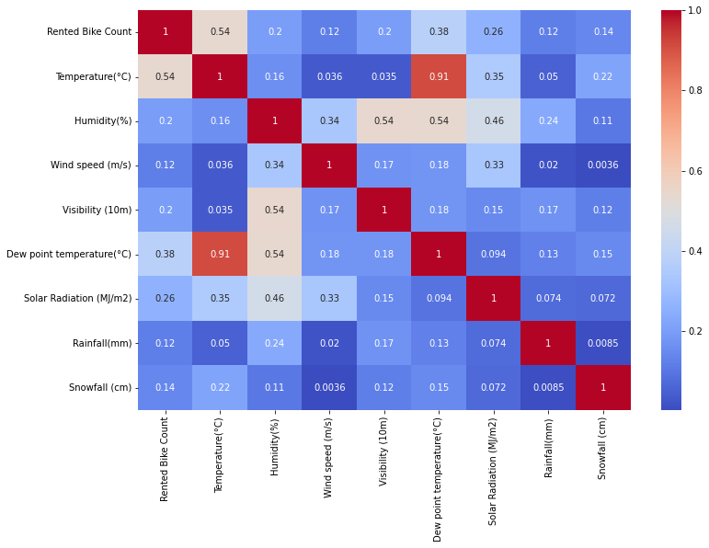
Check for Correlation among features
The features "Dew point temperature" and "Temperature" are highly correlated with correlation value as 0.91

Slide 23
Check for VIF values
Variables | VIF
Temperature(°C) | 29.075866
Humidity(%) | 5.069743
Wind speed (m/s) | 4.517664
Visibility (10m) | 9.051931
Dew point temperature(°C) | 15.201989
Solar Radiation (MJ/m2) | 2.821604
Rainfall(mm) | 1.079919
Snowfall (cm) | 1.118903
The features "Dew point temperature" and "Temperature" have high VIF values.

Slide 24
Check for VIF values after removing “Dew point temperature”.
Variables | VIF
Temperature(°C) | 3.166007
Humidity(%) | 4.758651
Wind speed (m/s) | 4.079926
Visibility (10m) | 4.409448
Dew point temperature(°C) | 2.246238
Solar Radiation (MJ/m2) | 2.821604
Rainfall(mm) | 1.078501
Snowfall (cm) | 1.118901
The VIF values significantly decreased for the features "Temperature" and "Visibility" and also VIF values for all numerical features are small now.

Slide 25
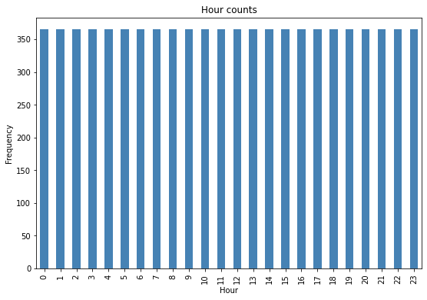
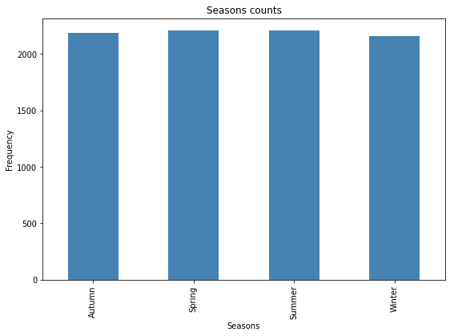
Categorical Features
Visualising using bar plot

Slide 26
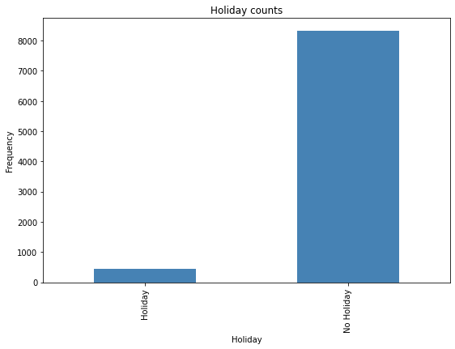
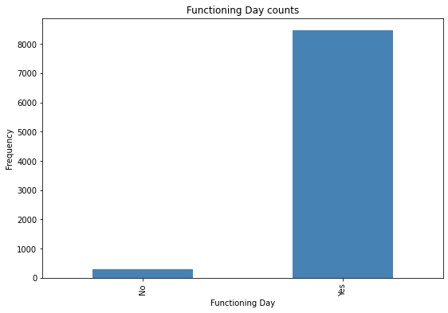
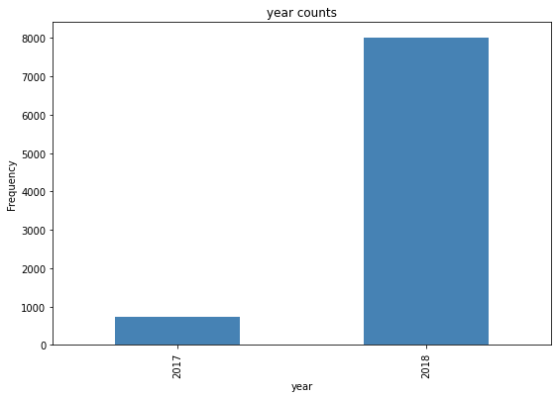
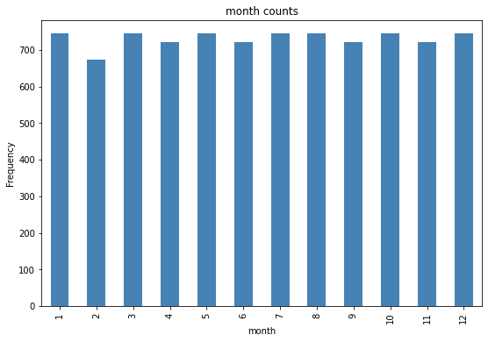

Slide 27
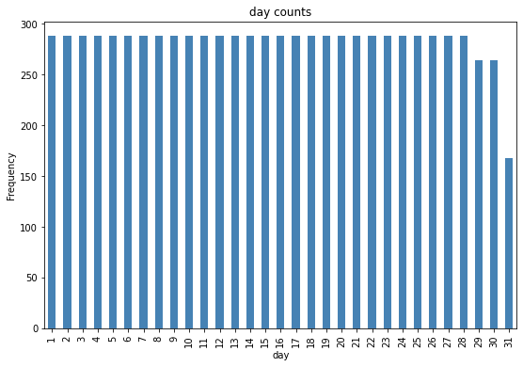
The demand is equal for every hour.
The demand is similar for every season.
The demand is more when there are no holidays.
The demand is more on functioning day.
The demand is seen more in the year 2018.
For every month demand is similar.
The demand is seen similar for each day , except at the month end.

Slide 28
Data Preparation before Modelling
The features “Temperature(°C)” and “Dew point temperature(°C)” are collinear so the combination of both have used . One of the features is not dropped , so as not to lose the information.
The square root transformation is used for the feature “Wind speed (m/s)” to remove the skewness.
The square root transformation is used for the response variable “Rented Bike Count” to remove the skewness,as for regression tasks it is also important to standardize the response variable.
The dataset is split into 80% train and 20% test.
The Standard Scaler is used to standardize the numerical features.
The One Hot Encoder is used to encode the categorical features as these features are nominal in nature.
The final train set has 7008 rows and 84 columns ,and final test set has 1752 rows and 84 columns.

Slide 29
Metrics Selection
The problem is to predict the rented bike count , in which it is very important to know what factors will derive the prediction well. So to use following metric for prediction will be a good choice.
R2 (R Squared) Score
Adjusted R2 Score
But we will also look into other metrics like " Mean Squared Error (MSE) " and " Root Mean Squared Error (RMSE) " to keep a check how much error is made in prediction.
R2 Score : The proportion of the variance in the dependent variable that is predictable from the independent variable(s).
Adjusted R2 Score : The percentage of variance in the target field that is explained by the input or inputs. It is a corrected goodness-of-fit (model accuracy) measure for linear models

Slide 30
Modelling
Linear Regression
Lasso
Ridge
Elastic Net
Decision Tree Regressor
Random Forest Regressor
Gradient Boosting Regressor
XGBoost Regressor

Slide 31
Model Performance Comparison
+-------------------------------------+-------+-------------+
| Model | R2 | Adjusted R2 |
+-------------------------------------+-------+-------------+
| Linear Regression | 0.779 | 0.768 |
+-------------------------------------+-------+-------------+
| Lasso (tuned) | 0.779 | 0.768 |
+-------------------------------------+-------+-------------+
| Ridge (tuned) | 0.779 | 0.768 |
+-------------------------------------+-------+-------------+
| Elastic Net (tuned) | 0.779 | 0.768 |
+-------------------------------------+-------+-------------+
| Decision Tree Regressor (tuned) | 0.835 | 0.827 |
+-------------------------------------+-------+-------------+
| Random Forest Regressor (tuned) | 0.891 | 0.886 |
+-------------------------------------+-------+-------------+
| Gradient Boosting Regressor (tuned) | 0.89 | 0.88 |
+-------------------------------------+-------+-------------+
| XGBoost Regressor (tuned) | 0.892 | 0.886 |
+-------------------------------------+-------+-------------+

Slide 32
Final Selected Model
The job is to predict the rented bike count in each hour, so for this Random Forest and XGBoost performs best with R2 score as 0.89. But we also have to look model explainability and feature importance into consideration so that we can derive the important factors for predictions and also the reasons for the same to explain and to improve the business model. The Decision Tree performs good with R2 score as 0.835. While the training time complexity of ensemble models is greater than of Decision Tree , the difference between the scores is not that big. The Decision tree gives feature importance easily and ensures model explainability. So the final model selected for the task is Decision Tree.

Slide 33
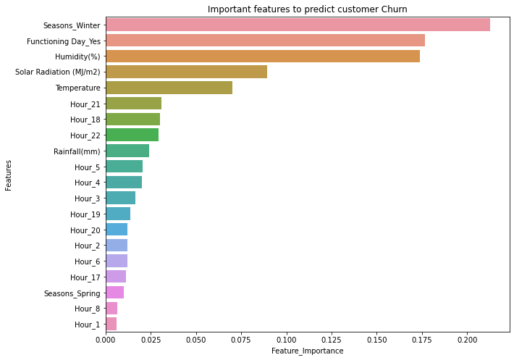
Feature Importance
Top 20 features which are important for prediction are used in the plot.
The "Season" feature as winter is the most important factor for the predictions. The "functioning_day" as yes , and Humidity are the other most important factors. The "Solar Radiation","Temperature" ,"Hour" as a whole feature and "RainFall"are next important factors. So these factors are the most important for the predicitons, therefore we need to focus on them to improve the business model.

Slide 34
Model Explainability
|--- Seasons_Winter <= 0.50
| |--- Functioning Day_Yes <= 0.50
| | |--- value: [0.00]
| |--- Functioning Day_Yes > 0.50
| | |--- Humidity(%) <= 1.25
| | | |--- Solar Radiation (MJ/m2) <= -0.65
| | | | |--- Hour_21 <= 0.50
| | | | | |--- Hour_22 <= 0.50
| | | | | | |--- Hour_4 <= 0.50
| | | | | | | |--- Hour_5 <= 0.50
| | | | | | | | |--- Hour_3 <= 0.50
| | | | | | | | | |--- Hour_2 <= 0.50
| | | | | | | | | | |--- Hour_6 <= 0.50
| | | | | | | | | | | |--- truncated branch of depth 6
etc..
The root node selected is "Seasons_winter" which is the most important feature also. The further splits based on the other top important features.

Slide 35
Summary
The job is to predict the number of rented bike counts each hour.
The dataset contains a total 14 features in which "Rented Bike Count" is response variable and other are predictor variables.
The dataset contains no missing values.
The dataset contains "Date" feature which has an object dtype, we changed the dtype of this feature to correct one.
The "Date" feature is splitted to "Year", "Month", and "Day" features for better understanding.
The "Hour" feature has dtype as int , we changed the dtype of this feature to correct one.
After modification the dataset has a total eight numerical features and seven categorical features.
The feature "Visibility" is negatively skewed and the features "Wind Speed", "Solar Radiation" ,"Rainfall" and "Snowfall" are positively skewed. The different transformations are used to remove skewness but only for the feature "Wind Speed", skewness can be removed using square root transformation.
The features "Wind Speed","Solar Radiation","Rainfall","Snowfall" have outliers.
The features "Dew point temperature" and "Temperature" are highly correlated. So we used the combination of both to remove correlated features from the dataset.

Slide 36
Each numerical feature is less correlated with the dependent variable and follow a non-linear relationship.
For categorical features , the demand is seen similar for each values of he features "Hour","Season","Month","Day" and the demand is seen more for the features "Holidays" as yes , "Functioning Day" as yes and the "Year" value as 2018.
The response variable is positively skewed, so to remove the skewness different transformations are used. The most effective is square root transformation.
The numerical features are scaled and categorical features are one hot encoded before passing to the model.
The key metrics to be noticed are R2 and adjusted R2.
Both Linear and Non Linear Models are used in the task.
The Linear Regression, tuned Lasso,Ridge and ELasticNet gives R2 score as 0.779 and adjusted R2 score as 0.768.
The Decision Tree Regressor gives R2 score as 0.835 and adjusted R2 score as 0.827.
The Random Forest, GradientBoosting, XGBoost Regressors give around R2 as score 0.89 and adjusted R2 score as 0.88.
The highest scores can be seen for ensemble models.

Slide 37
Conclusions
Taking model explainability and feature importance into account the Decision Tree is selected as final model.The Decision Tree gives R2 score as 0.835.
The "Season" feature as winter is the most important factor for the predictions. The "functioning_day" as yes , and Humidity are the other most important factors. The "Solar Radiation","Temperature" ,"Hour" as a whole feature and "RainFall"are next important factors. So these factors are the most important for the predictions, therefore we need to focus on them to improve the business model.
Challenges Faced
The dataset contains skewed predictor variables.
The response variable was also skewed.
Choosing the right metric was a challenge.

Slide 38
Thank You

